Slide 1
Graph Neural Networks
Graph Neural Networks

Slide 2
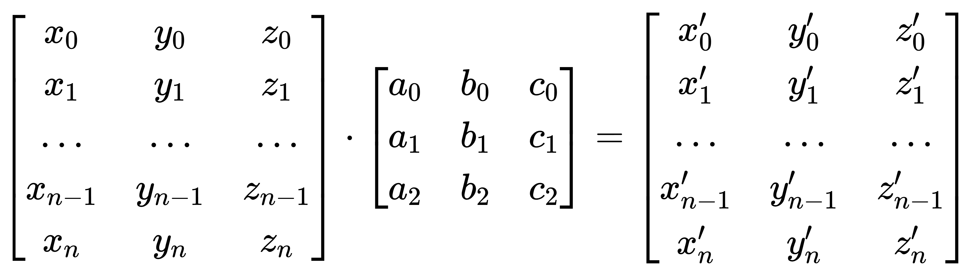



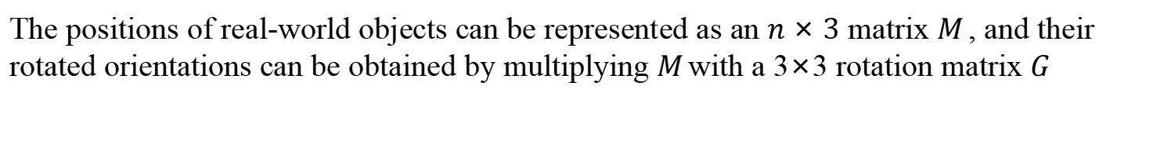
Equivariance
The positions of real-world objects can be represented as an $n×3$ matrix 𝑀, and their rotated orientations can be obtained by multiplying 𝑀with a 3×3 rotation matrix 𝐺
Graph Neural Networks

Slide 3
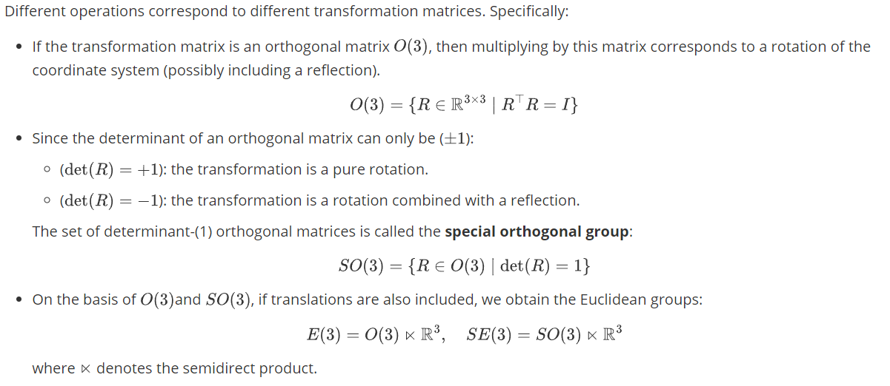
Equivariance
Graph Neural Networks

Slide 4
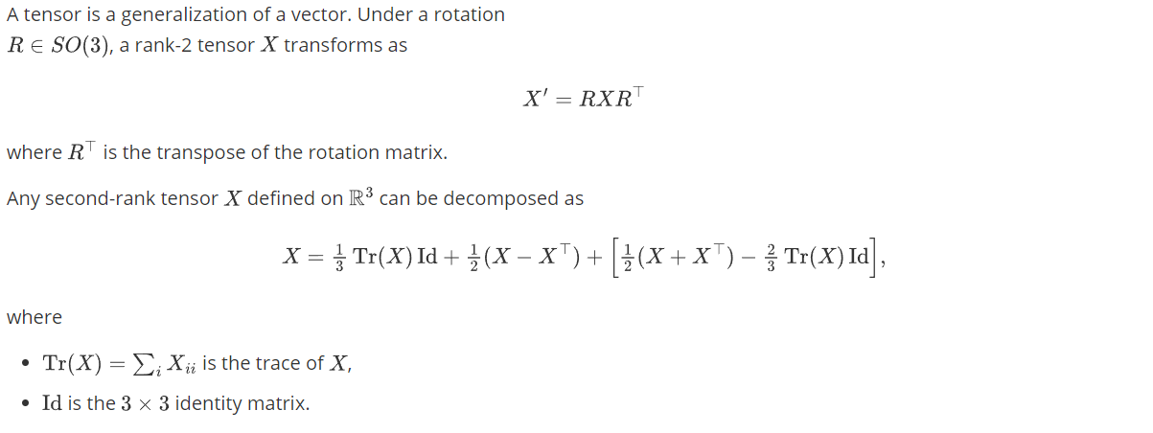
Graph Neural Networks
Graph Neural Networks

Slide 5
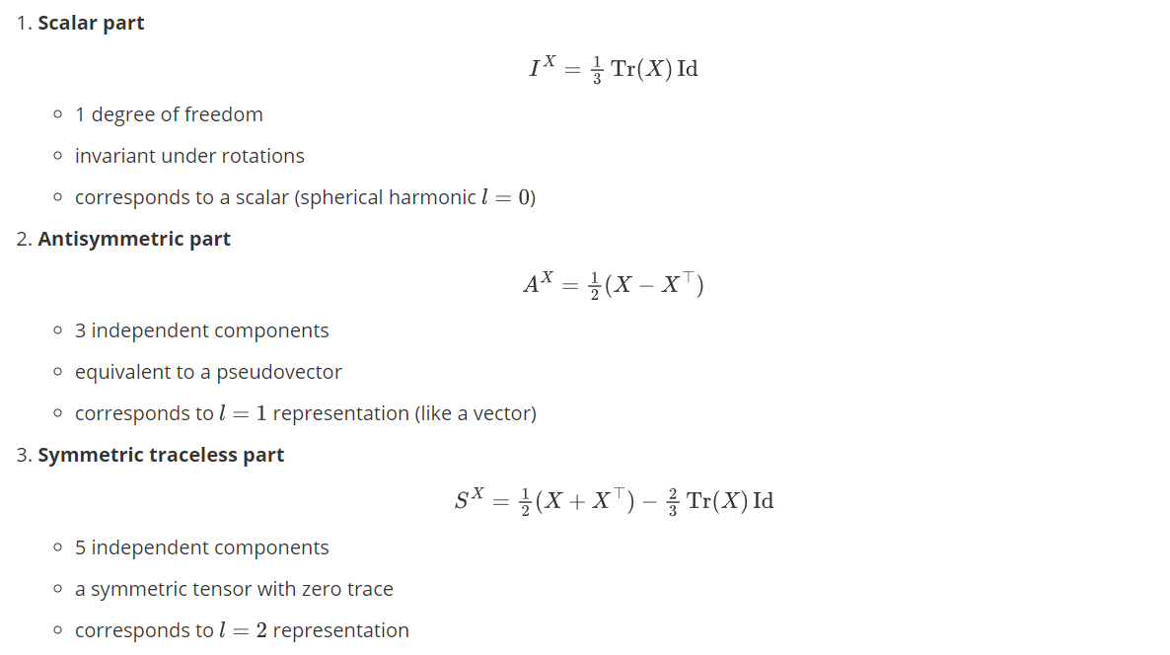
Graph Neural Networks
Graph Neural Networks

